Slide 1
Disability Inclusion
Notes:
In this presentation I will talk about Disability Inclusion, including:
what it is and what it means for our school and your child
funding available for our school and how we plan to use it
the Disability Inclusion Profile and what happens in the meeting, who is involved and what you need to know.

Slide 2
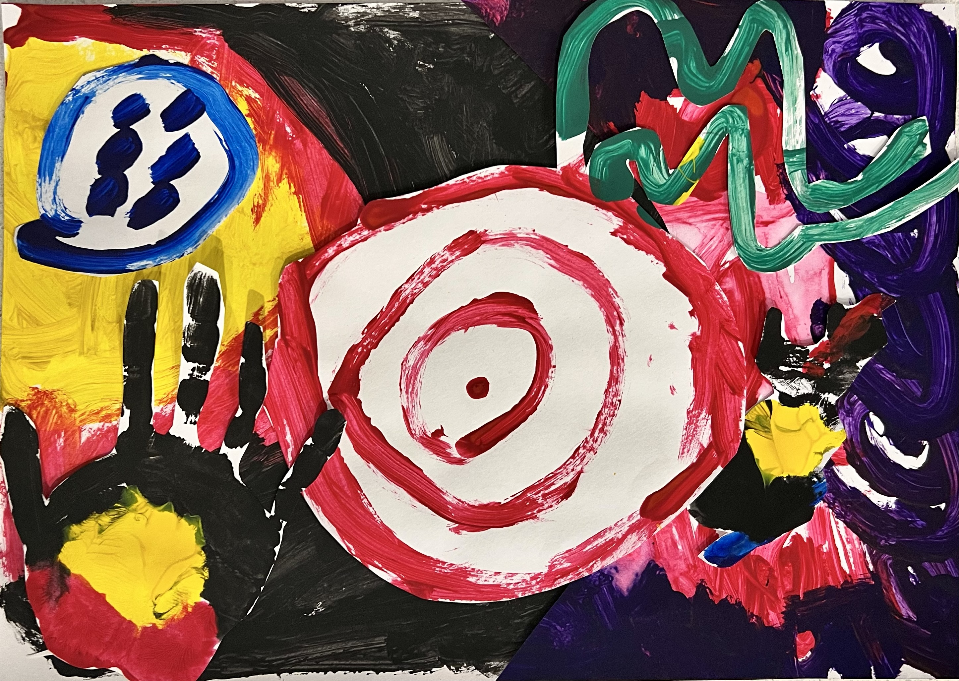
Acknowledgement of Country
I acknowledge the Traditional Owners of the land on which we meet, and pay my respects to their Elders past, present and emerging.
Artwork by students from Barwon Valley Special School - Zackery Kenyon, Xavier Thomas, Chester McKenzie and Connor Brooks
Notes:
Sharon to deliver

Slide 3
Key parts of Disability Inclusion
A new tiered funding model
A new funding model is being rolled out with more investment to help us support inclusive practices. The model will allow us to make the adjustments our students need to help with their participation, engagement and learning at school. It provides additional investment that our school can use to support groups of students like those with autism, ADHD and other learning difficulties.
A new Disability Inclusion Profile
The profile will help our school and families identify the strengths, needs and educational adjustments we can make to help students with disability.
The profile will be completed with the support of key people who understand the student’s education and support needs. An independent facilitator will help us work through the profile with families.
Investment in building skills and knowledge in inclusive education
A range of new activities and supports will build the knowledge and skills of our school’s workforce. This means our school staff will have more access to specialist expertise, coaching, professional learning and support.
Our school must make reasonable adjustments to ensure students with disability can access and participate in education on the same basis as students without disability.
Notes:
Schools across the state will transition to Disability Inclusion before 2025.
Our school will start to transition from [XXXX] (refer to https://www.education.vic.gov.au/school/teachers/learningneeds/Pages/disability-inclusion.aspx for the rollout schedule)
The new tiered funding model provides additional investment, and will allow it to be spread evenly to include other groups of students, like those with autism, ADHD, and other learning difficulties
The Disability Inclusion Profile and tiered funding model will roll out progressively.
It will replace the current Program for Students with Disabilities (PSD).
The Disability Inclusion Profile is a strengths-based approach to assess need and work out the individual adjustments for students to help with their learning. Independent facilitators will run the meeting and bring together the parents and carers, teachers, and the student themselves.
There is a number of initiatives that aim to build skills and knowledge in inclusive education. Our teachers and support staff will have access to resources, training and coaching that will allow them to better support students at our school.

Slide 4
Disability Inclusion Funding Model
The funding model has three tiers of funding and support, based on the level of need and the adjustments required to support a student’s learning and participation at school.
Tier 1
Tier 2
Tier 3
There is no change to the universal funding tier for all students (Student Resource Package).
The funding will support more students with disability through adapted teaching, targeted support and school-level adjustments.
This funding is formula-based. It will provide our school with a flexible, sustainable and predictable funding source for adjustments.
The funding is not for individual students. All students can benefit from this funding and do not need to do anything to access it.
The third tier will broadly replace the funding our school receives through the Program for Students with Disability.
It will ensure students with the highest needs continue to receive the personalised support they need – identified through the new Disability Inclusion Profile.
Notes:
This is the new funding model.
Tier 1 hasn’t changed. Our school will receive funding as always through our regular budget.
Tier 2 is school-level funding that can be used for:
more training and professional development for teachers and school staff
getting expert advice about disability
hiring teachers or other staff to help plan and deliver teaching and learning programs and adjustments for students
equipment and resources to support learning
Students who haven’t been eligible for individual funding through the Program for Students with Disabilities (PSD) in the past can benefit from this tier of funding.
Tier 3 is to support individual students who have high and complex needs. Over time, this will replace the PSD. With Disability Inclusion, current supports will continue for students, and more support will be provided if needed. A Disability Inclusion Profile will be created for the student, and this will help determine the support provided.

Slide 5
The Disability Inclusion Profile
Features
A Disability Inclusion Profile is a written description of a student’s strengths and needs that will help us plan what will work best for a student.
It will inform personalised funding allocations and will replace the current Program for Students with Disabilities (PSD).
The profile will also be available to a broader group of students with disability.
Profiles are completed at a Student Support Group meeting with the student and people who know them.
Our school will:
begin to complete profiles, with an initial focus on students entering [amend as appropriate prep/Year 7]
ask you to provide consent for your child to have a profile created
work with you to find a suitable time to complete a profile for your child if it is needed
gather information for the profile meeting, including any relevant supporting information such as NDIS plans or other assessments
use the student’s profile to help inform personalised funding allocations and adjustments for the student or groups of students
include agreed adjustments into the student’s Individual Education Plan
identify students who are not currently part of the PSD who may benefit from a profile.
Strength-based focus A student’s functional needs and adjustments are identified through a strength-based discussion.
Greater access
The profile will be available to a broader group of students with disability.
Facilitated and supported
Disability Inclusion facilitators will be trained in the profile and will support schools and families to work together through the new approach.
Shared understanding
The profile will help participants identify and discuss the student’s needs and required adjustments, as well as building capacity in schools. It will inform personalised funding allocations for students with high needs.
Notes:
The Disability Inclusion Profile is based on the World Health Organisation’s International Classification of Functioning.
The profile will help identify the student’s needs and the required adjustments.
It’s designed to focus on the student.
It will bring together all of our knowledge about the child into a description of a child's strengths and needs and adjustments that are made for the student to help with their participation, engagement and learning at school.
The report will detail the student’s current strengths, aspirations, functional needs and adjustments to the learning environment
The profile will inform personalised funding allocations for students with high needs. This is part of the Tier 3 funding that replaces the PSD.
While not all students who complete a profile will attract personalised funding, the strength-based conversation will inform planning for these children and they may benefit from Tier 2, school-level funding.
A facilitator will help deliver each student’s Disability Inclusion Profile through a Student Support Group meeting.
NOTE FOR SECONDARY SCHOOLS – Some Year 7 students with PSD funding may need to complete a profile in their first year. Students in Years 8-12 with PSD funding have three years in which to complete a profile.

Slide 6
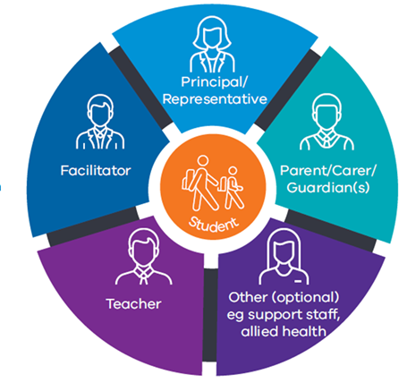
Student Support Group profile meeting
If needed, you will be invited to take part in a special Student Support Group meeting to create your child’s Disability Inclusion Profile.
An independent facilitator will run the meeting and help to complete the profile. The meeting will run for about 90 minutes.
At the meeting
The group will:
talk about the student’s strengths, goals and functional needs (what the student needs to help them participate and learn at school)
talk about the adjustments the student needs to allow them to participate on an equal basis as their peers
talk about the level of adjustment that is required for each school-related activity
share ideas, understand one another’s point of view and share responsibility.
After the meeting
parents and carers and the school will receive a profile report in the weeks following the meeting. They can discuss it at a Student Support Group meeting
the Student Support Group will decide when the student needs a new profile (this may be when the child is preparing to transition from different school settings or when their needs change)
the Student Support Group will regularly check on how the student is responding to adjustments and whether they are being implemented as intended.
Notes:
Some families already participate in Student Support Group meetings. A special Student Support Group meeting will be held to complete a Disability Inclusion Profile.
The meeting will consist of parents/carers (and case worker from the Department of Families, Fairness and Housing for students in statutory out-of-home care), the teacher [primary - classroom teacher; secondary - teacher who knows the student best; specialist - the student’s regular teacher or teacher they are most frequently taught by], the student themselves, principal or member of the leadership team, an independent facilitator and others as needed.
[For secondary school students, the student’s teachers and relevant staff will provide input prior to the profile meeting so the teacher who attends has a full picture of the student’s strengths, needs and adjustments across classes.]
To prepare for the meeting, you may want to spend time thinking about your child’s strengths, aspirations, and functional needs.
It is important that students play an active and age-appropriate role in the profile process and contribute to the discussion and decision-making process, either in person or via a trusted adult. Students can express their views in the meeting, or they can contribute with photos, video and audio recordings, drawings and other methods.
There is a Student Voice Toolkit and an Inclusive Student Voice Toolkit on the department’s website, which we can send you the links to if you wish.

Slide 7
Our school
We have three years to complete a Disability Inclusion Profile for students who are currently receiving Program for students with Disability (PSD) funding. If your child is part of the PSD, we will work with you to find the most suitable time to complete your child's profile.
If you have concerns about the adjustments being made for your child, you should discuss this with [insert contact at your school]
Changes at our school
We will start to use school-level funding to make adjustments that suit student needs, including [insert relevant adjustments].
Teaching and school staff will be better prepared to respond to our student’s needs. [insert some of the professional learning staff are undertaking]
Our school’s inclusive culture will further develop so that all students are supported and can succeed in life and in school.
We know that inclusive schools have better outcomes in learning, engagement and wellbeing for all students.
Notes:
[Secondary schools please note that some Year 7 students may need to do a profile in their first year.]
Being part of the Disability Inclusion process does not guarantee that a school will receive individual funding to support a student. Individual funding is based on a student’s needs and their school setting.
Disability Inclusion Tier 2 funding allows the school to make better adjustments for all students with disability. Schools can use this funding to hire teachers or other staff to help plan and deliver adjustments for students, purchase equipment and resources to support learning, provide professional learning for staff and get expert advice.
These may be school-wide to support students across the whole school or to address the specific needs of a student.

Slide 8
Other Disability Inclusion initiatives underway
Diverse Learners Hub – The hub will improve how schools meet the learning and wellbeing needs and aspirations of diverse learners, with a focus on those with dyslexia, dyscalculia, autism and attention deficit hyperactivity disorder (ADHD)
Inclusion Outreach Coaching Initiative– initiative to support mainstream schools to implement inclusive practices with support and expertise from Inclusion Outreach Coaches through coaching, collaboration, and professional learning
Inclusive Education Professional Learning – this aims to provide professional learning for schools to improve the inclusion of students with diverse learning needs
Master of Inclusive Education and graduate certificate initiative – this will support 600 Victorian government school teachers to undertake professional learning through a Masters of Inclusive Education (MIE) or a Graduate Certificate In Education (Learning Difficulties)
Equipment Boost for Schools – this initiative funds new equipment and assistive technologies to enable students with disability and additional needs to fully participate, learn, develop and succeed in school
Strengthening Inclusive School Communities– the department is creating resources and information for parents to help with understanding Disability Inclusion
Notes:
These initiatives will improve the teaching and learning of students with disabilities, as well as improving inclusive practices and cultures in schools.

Slide 9
More information
Visit:
www.education.vic.gov.au/disabilityinclusion
Email:
disability.inclusion@education.vic.gov.au
Contact [insert contact at your school] to discuss your child’s circumstances
Questions?

